Slide 1
안드로이드
Fragment with RecyclerView

Slide 2
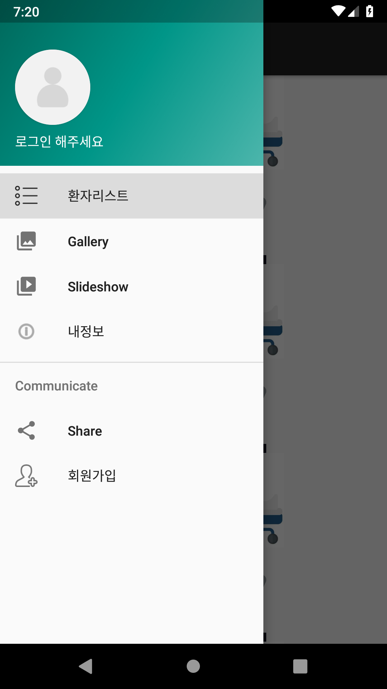
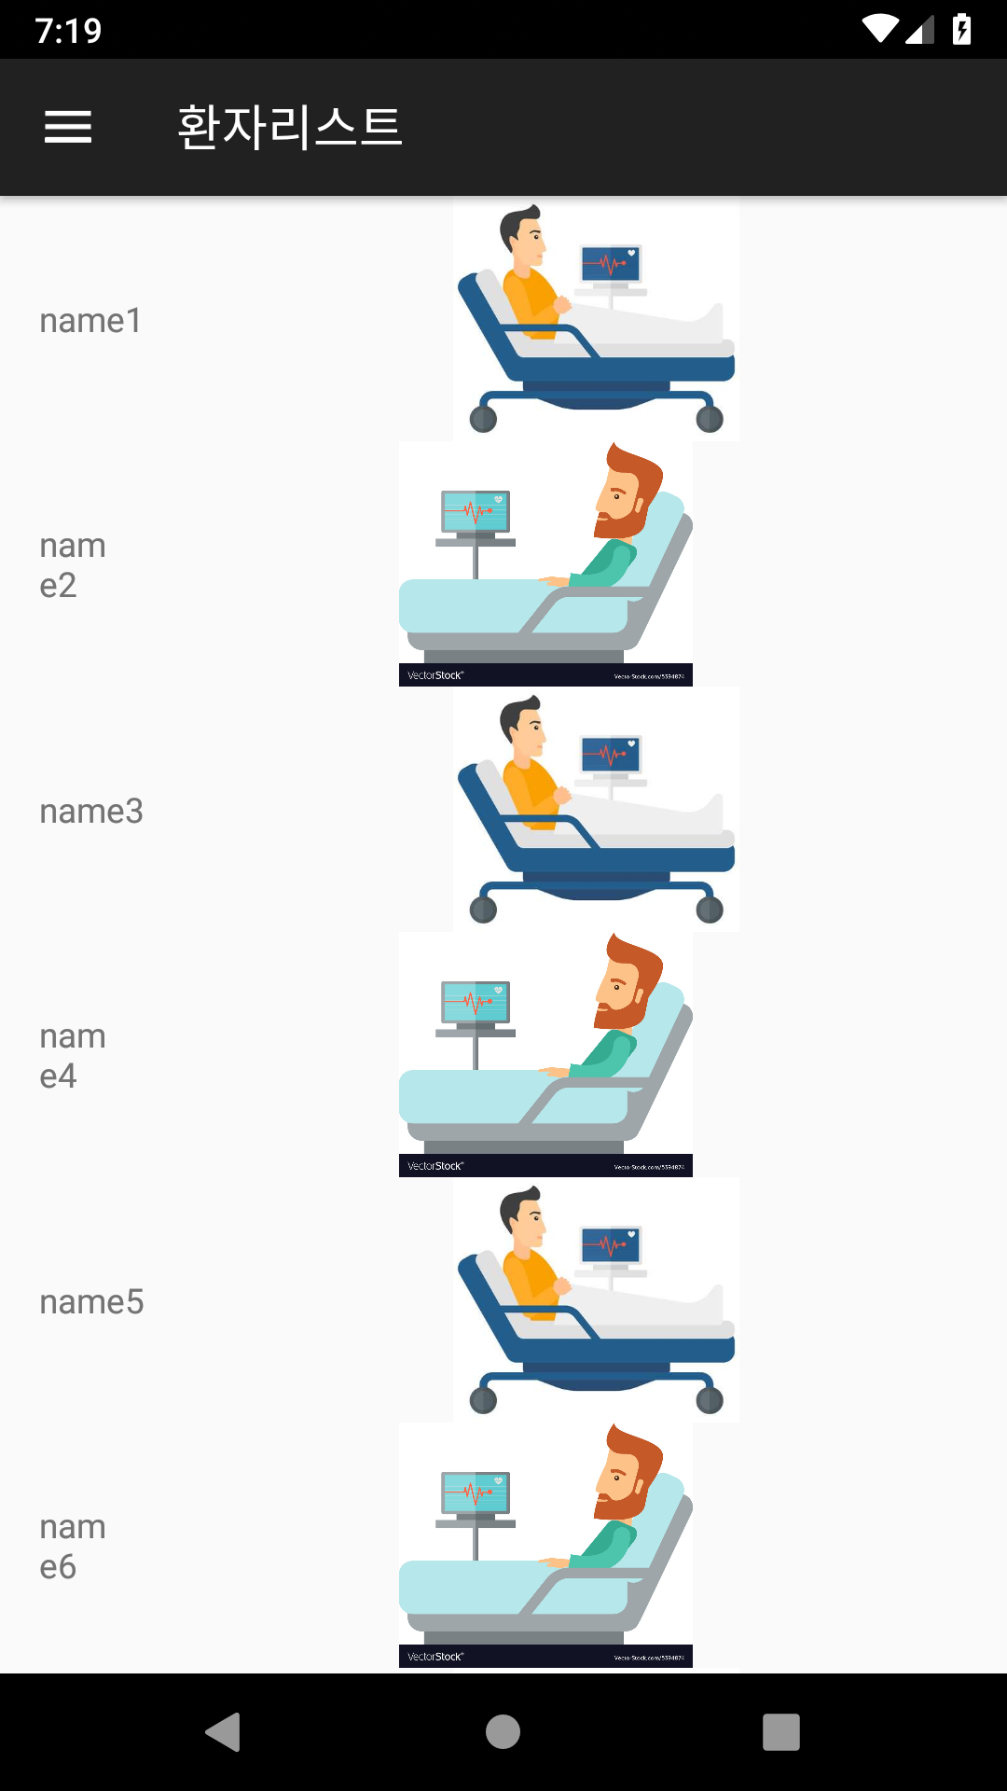
리스트를 화면에 보여주는 RecyclerView

Slide 3
1). MainActivity.java 에서 시작하기
@Override public boolean onNavigationItemSelected(MenuItem item) {
FragmentTransaction fragmentTransaction = getSupportFragmentManager().beginTransaction();
Fragment fragment = new PatientListFragment();
if(fragment != null){ fragmentTransaction.replace(R.id.content_main , fragment); fragmentTransaction.commit(); }
DrawerLayout drawer = (DrawerLayout) findViewById(R.id.drawer_layout);
drawer.closeDrawer(GravityCompat.START); return true;
}

Slide 4
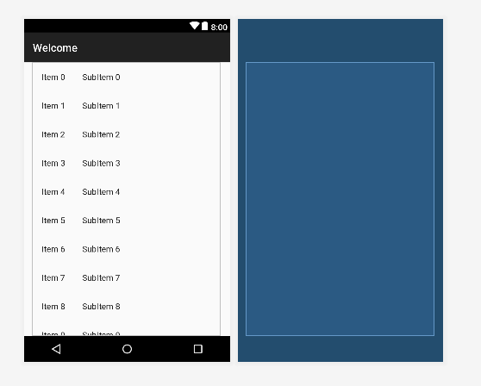
2-1).fragment_patient_list.xml

Slide 5
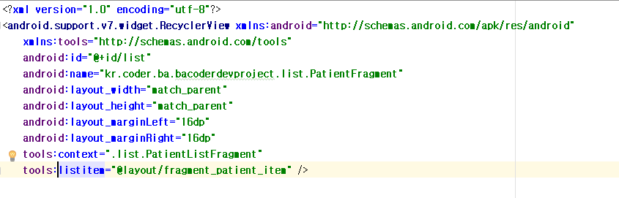
2-2). fragment_patient_list.xml

Slide 6
3-1). PatientListFragment.java
public class PatientListFragment extends Fragment {
private final static String TITLE = "환자리스트";
RecyclerView recyclerView; // 리스트가 표시됨 private PatientAdapter adapter; // 리스트 내 정보를 표시함
}

Slide 7
3-2). onCreateView()
@Override public View onCreateView(LayoutInflater inflater, ViewGroup container, Bundle savedInstanceState) { recyclerView = (RecyclerView)inflater.inflate(R.layout.fragment_patient_list, container, false); recyclerView.setLayoutManager(new LinearLayoutManager(getContext())); updateAdapter(); return recyclerView; }

Slide 8
3-3). updateAdapter() : 서버에서 가져온 정보를 화면에 표시한다.
private void updateAdapter(){ final List<Patient> list = new ArrayList<>(); RequestQueue rq = Volley.newRequestQueue(getContext()); StringBuilder url = new StringBuilder(); url.append("http://www.bacoder.kr/getPatients.jsp"); JsonObjectRequest jsonObjectRequest = new JsonObjectRequest(Request.Method.GET, url.toString(), null, new Response.Listener<JSONObject>() { @Override public void onResponse(JSONObject response) { try { JSONArray array = (JSONArray) response.get("list"); Log.d(TAG, "array leng: " + array.length()); for(int i=0; i<array.length(); i++){ JSONObject obj = new JSONObject(array.getString(i)); Log.d(TAG, obj.toString()); Patient patient = new Patient(); patient.setId(obj.getInt("id")); patient.setName(obj.getString("name")); patient.setPhoto(obj.getString("photo")); patient.setP_date(obj.getString("p_date")); list.add(patient); } adapter = new PatientAdapter(list); recyclerView.setAdapter(adapter); } catch (JSONException e) { e.printStackTrace(); } } }, new Response.ErrorListener() { @Override public void onErrorResponse(VolleyError error) { } }); rq.add(jsonObjectRequest); }

Slide 9
3-4) 내부클래스 PatientHolder
protected class PatientHolder extends RecyclerView.ViewHolder { Patient patient; @BindView(R.id.list_title_view) TextView titleText; @BindView(R.id.list_thumbnail_view) ImageView thumbnailImg; public PatientHolder(View itemView){ super(itemView); ButterKnife.bind(this, itemView); } public void bindItem(Patient patient){ this.patient = patient; titleText.setText(patient.getName()); Picasso.with(getContext()).load(patient.getPhoto()).into(thumbnailImg); } }

Slide 10
3-5) 내부클래스 PatientAdapter
private class PatientAdapter extends RecyclerView.Adapter<PatientHolder> implements View.OnClickListener { private List<Patient> items; public PatientAdapter(List<Patient> items){ this.items = items; } @Override public void onClick(View view) { Fragment fragment = new PatientFragment(); FragmentTransaction fragmentTransaction = getActivity().getSupportFragmentManager().beginTransaction(); fragmentTransaction.replace(R.id.content_main , fragment); fragmentTransaction.commit(); } @NonNull @Override public PatientHolder onCreateViewHolder(@NonNull ViewGroup parent, int viewType) { LayoutInflater layoutInflater = LayoutInflater.from(getActivity()); View view = layoutInflater.inflate(R.layout.list_item, parent, false); view.setOnClickListener(this); return new PatientHolder(view); } @Override public void onBindViewHolder(@NonNull PatientHolder holder, int position) { Patient patient = items.get(position); holder.bindItem(patient); } @Override public int getItemCount() { return items.size(); } }

Slide 11
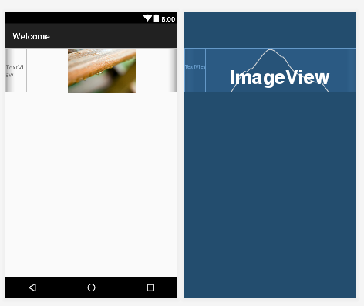
4-1) list_item.xml

Slide 12
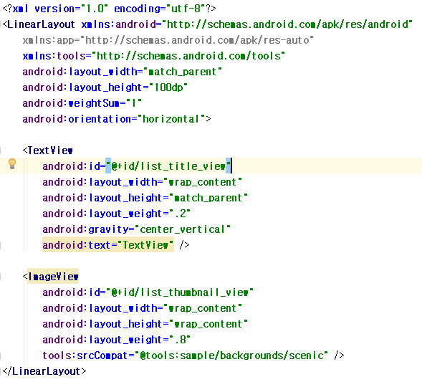
4-2) list_item.xml

Slide 13
5). Patient.java 정보를 저장하는 클래스
public class Patient { private int id; private String photo; private String p_date; private String name;
// getter & setter
@Override public String toString() { return ToStringBuilder.reflectionToString(this, ToStringStyle.JSON_STYLE); }
}

